Slide 1
NExt generation high poWer fuel cells for airBORNe applications
Digital twin presentation
Jan Belak
Matthieu Ponchant
02-08-2024
Notes:
I’m pleased to introduce you a Clean Aviation project called NEWBORN, NEWBORN stands for Next generation high power fuel cells for airborne applications, European Research project where Honeywell and Siemens are contributing to.
Not easy to find the project website:
https://newborn-project.eu/

Slide 2
agenda
What is NEWBORN about?
Digital twin
Modeling activities with Simcenter Amesim within NEWBORN
Preliminary results
Conclusions & prospects
Notes:
Today’s agenda, I will first introduce the general scope of NEWBORN before providing you more insights on the digital twin, digital twin being developed on Simcenter Amesim. Then, I will provide you some insights on their modeling and simulation activities with Simcenter Amesim followed by some preliminary results and finally, I will draw some conclusions and prospects.

Slide 3
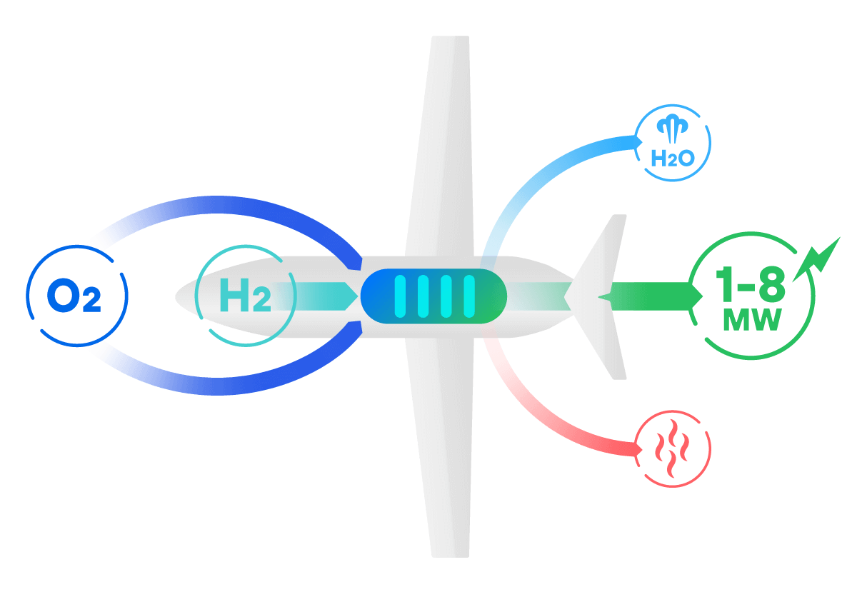
Ambition
Aerospace-grade & modular hydrogen-electric propulsion demonstrator by 2026
System level LHV efficiency ≥50%
Aligned with HERA aircraft architecture (CS-25 class)
Applicable for the CS-23 class
Notes:
The ambition of NEWBORN is to develop an hydrogen fuel cell based aircraft propulsion system with an overall efficiency of 50 % by 2026, which is really ambitious knowing the efficiency of fuel cell technology.
In this project, we are considering a PEMFC technology. The system should fulfill HERA aircraft architecture. HERA is another European Research project also part of Clean Aviation and led by Leonardo Aircraft, thus more focused on a platform like the regional aircraft ATR-72 which falls under the certification CS-25.
Moreover, this system shall be directly applicable to smaller aircraft, general aviation, being applicable to the largest CS-23 (general aviation) class of 19-seater commuters.
Last but not least, NEWBORN develops and demonstrate the TRL4 (TRL = Technical Readiness Level; TRL6 = a product can eventually be considered as industrial – which does not mean it will fly) ground demonstrator of the overall propulsion system using fuel cells technology for electricity generation.
So here, we are talking about a ground demonstrator from the cryogenic tank – indeed LH2 is consider due to gravimetric index of tanks to the electric machine driving the propeller, going through the fuel cell, air line, hydrogen line and all the thermal management system, electric network, converters and so on.

Slide 4
Partners
13 partners work on 28 key enabling technologies
Notes:
This project is gathering 13 partners who will jointly work to the development of 28 key enabling technologies. This consortium is a great mix of industrial and top European researcher center or academic partners. Project is led by Honeywell, Pipistrel is the airframer integrator, Powercell is developing the fuel cell, Fraunhofer, CIRA, The University of Nottingham, KU Leuven and Erlangen university are well know research centers and universities. Customcells works on batteries, Reaction engines brings their know how on heat exchangers, Test-fuchs their expertise on valves and hydrogen, Siemens their modeling and simulation expertise,

Slide 5
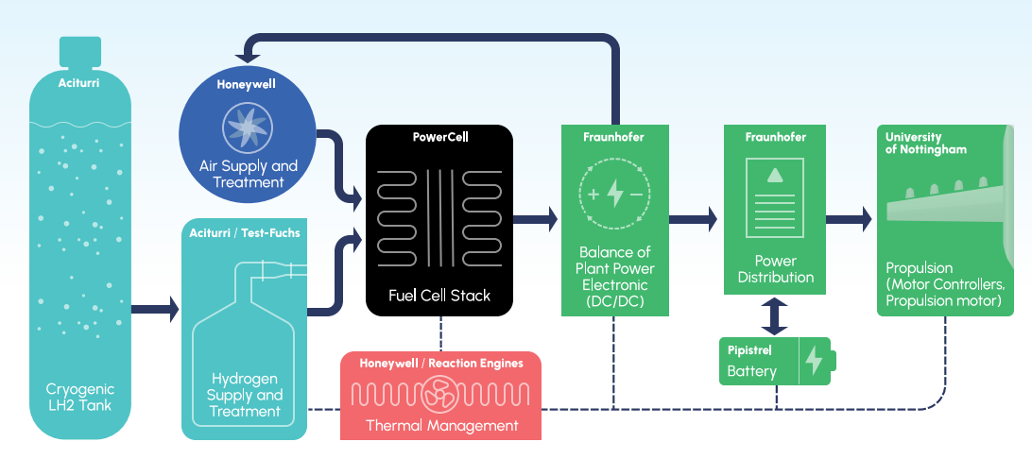
Digital twin
First-principles dynamical modeling within Simcenter Amesim
Modular development from subsystems
to complete system integration
Real-time testing (HiL)
Virtual up- and downscaling of power levels (up to 3MW)
Notes:
the interest of the digital twin are multiple:
Subsystem design
Subsystem interaction analysis
Control calibration & validation thanks to real-time compatible model
Upscaling to regional aircraft & mini-liner (CS23& CS25), meanwhile the baseline model is focusing on a ground demonstrator
Let’s start with a review of all subsystem, necessary to have a complete Fuell Cell system.

Slide 6
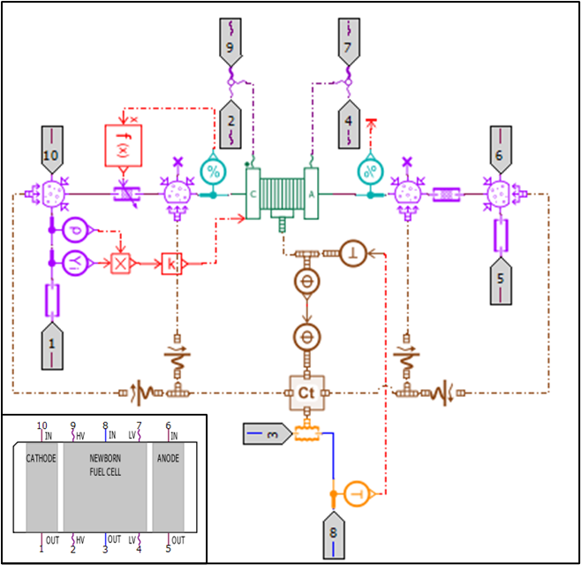
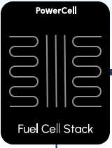
Fuel Cell stack
Zero-dimension model based on electrochemical equations
Calibrated using multiple VI curves for different operating conditions
Sensitivity to pressure, temperature humidity and H2, O2 stoichiometry
System interfaces
Balance of Plant (Air and hydrogen lines)
Electric network and thermal management
Notes:
The heart of the system is composed by the cell stacks. They are provided by Powercell.
Indeed this component being multi-physics, this component must be connected to others subsystems that will be described just after.
A lot of variables must be controlled to ensure reliability and performance:
Pressure
Temperature
O2 & H2 mass flow rate
Voltage...

Slide 7
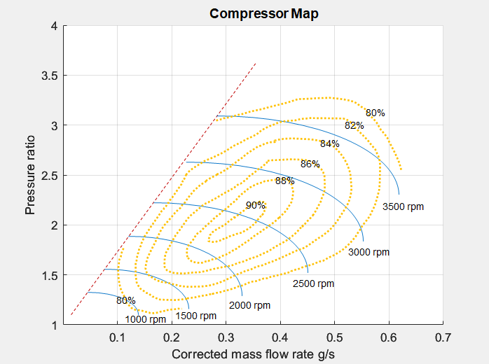
Air supply
Tasked to achieve correct
Pressure, Temperature and Flow rate
Humidity and water recovery
Architecture
Compressor and Turbo-compressor stages
Heat-exchangers
Water management system
Challenges: calibration, start-up, small volumes and control
Notes:
Then these previous cells must be fed by gases:
O2 from air line in one hand
Insuring right pressure, temperature and mass flow rate thanks to compressors and heat exchangers
H2 from hydrogen line
This subsystem is split in two parts
Liquid at first from cryogenic tank
Gaseous then at fuel cell inlets after flowing through a vaporizer

Slide 8
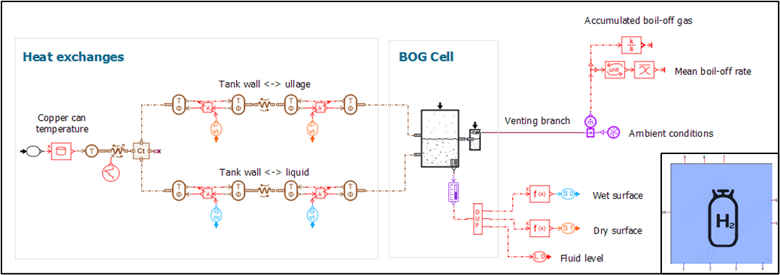
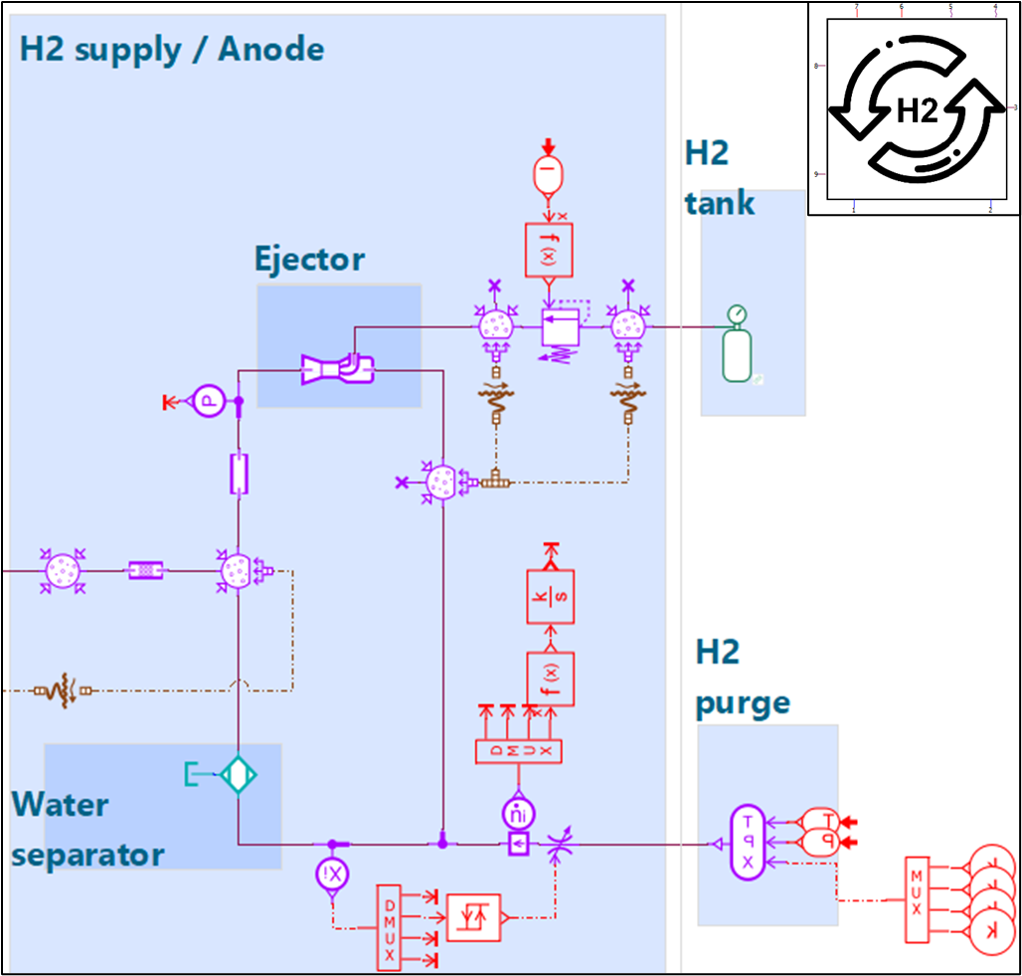
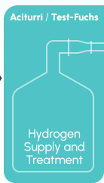
Hydrogen supply line
Liquid hydrogen management
Cryogenic tank
Evaporator and preheating to correct temperature
Gass hydrogen management
GH2 recirculation loop
Nitrogen purging system
Notes:
Then these previous cells must be fed by gases:
O2 from air line in one hand
Insuring right pressure, temperature and mass flow rate thanks to compressors and heat exchangers
H2 from hydrogen line
This subsystem is split in two parts
Liquid at first from cryogenic tank
Gaseous then at fuel cell inlets after flowing through a vaporizer

Slide 9
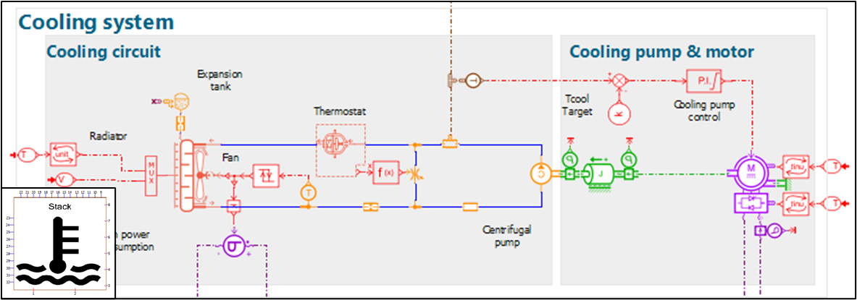
Thermal Management
Fuel cell gross LHV efficiency 60% - 40% is generated heat
Take-off: Critical condition - High power, low speed
10% heat reused in the system
4 cooling circuits
Fuel cell stacks
E-machine (oil & coolant)
Battery
Optimization of air duct geometry and coolant transport system components
Notes:
The thermal management is a key subsystem, because almost 40% of the power is transferred to the thermal management, especially if a 60% overall efficiency is achieved:
The fuel cell must work in different complex scenario
From cold environment with low pressure
To high temperature on ground during summer, like during taxiing
4 different cooling circuits
Fuel cell stacks
Battery
E-machine (oil & coolant)
optimized air duct to ensure reliable fuel cell system

Slide 10
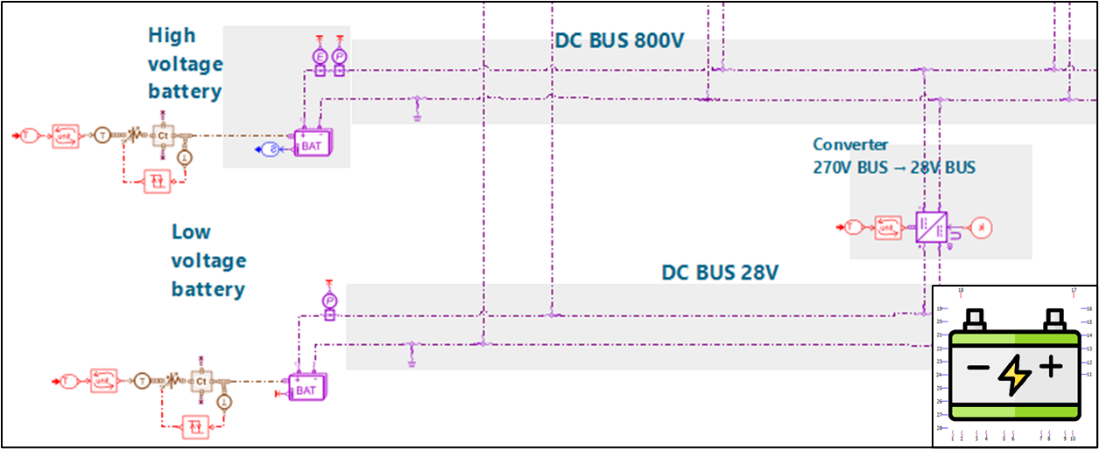
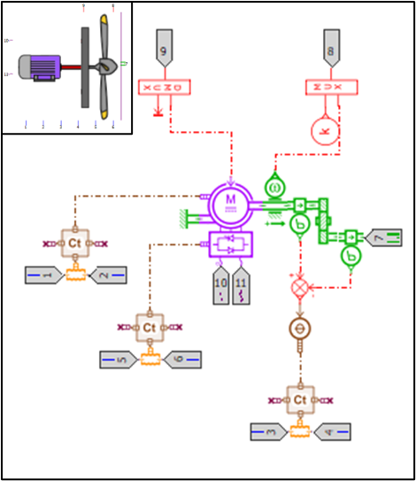
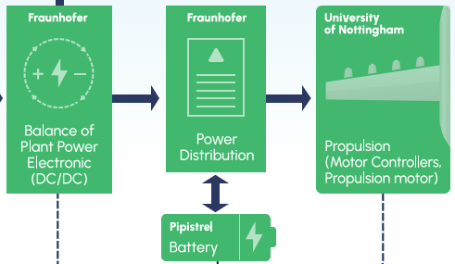
Power line
Power line
4 voltage levels
E-powertrain
Inverter
Electric machine
Subsystems | E-powertrain | Battery | Fuel cell | Auxiliaries
Voltage | 900 V | 800 V | 270 V | 28 V
Notes:
The power line is another transversal subsystem like thermal management, because connected to all other subsystems, like the nervous system.
4 different voltage circuits are necessary to handle all subsystem requirements and are all interconnected thanks to DC/DC converters:
E-powertrain at 900V
The batteries at 800V
The fuel cell working at 270V
And all auxiliaries working at 28V.
The E-powertrain is composed of 2 electrics components:
The inverter converting the DC current into AC current
the E-motor driving the rotors.

Slide 11
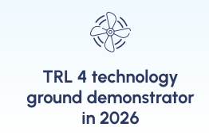
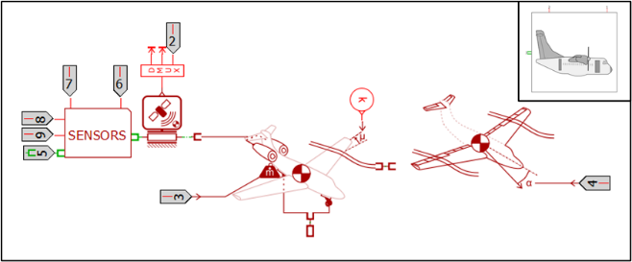
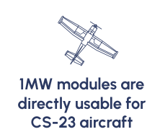
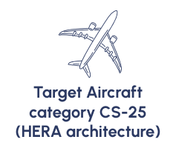
Flight dynamic
Objectives
Deliver boundary conditions of the Fuel cell demonstrator
During complete flight mission for complete validation
Ground demonstrator
CS19 & CS25 flight mission
Interaction with others Clean Aviation projects
Notes:
The last physical subsystem deals with the mission and the flight dynamic. This subsystem is different based on different demonstrators.
Indeed the initial ground demonstrator is then scaled up for CS23 and CS25 aircraft. The CS25 configuration will be shared with other Clean Aviation projects.

Slide 12
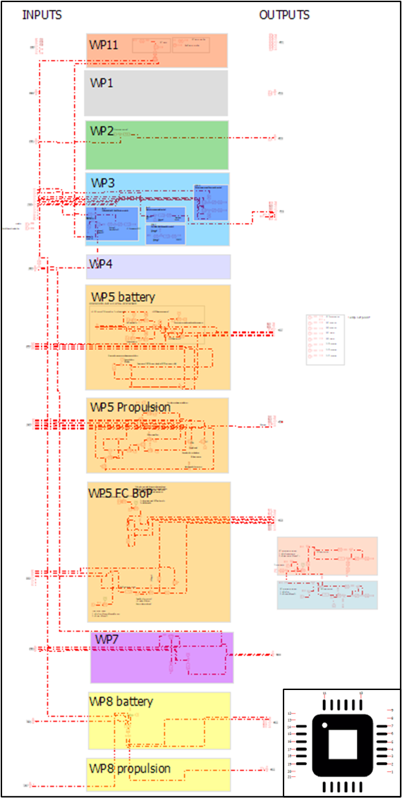
Control
Model in the loop
PID- based control
Subsystem functional control
Linearization capabilites
Simulation based
SIL and HIL in development
Real-time interface with Simulink based control
Notes:
One purpose of the digital twin is the control validation sooner in the design phase.
Functional controls have been used to check the overall behavior of the Digital Twin to ensure its reliability.
Then this digital Twin will be connected to hardware, meaning using a realtime compatible model

Slide 13
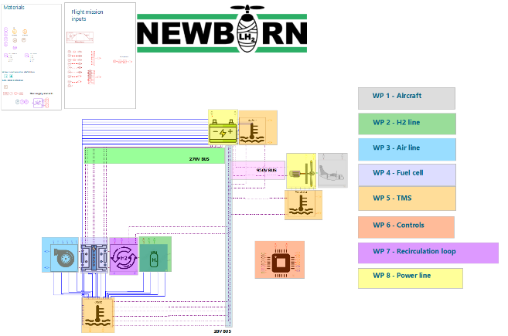
Digital Twin
All subsystems integrated
Cooling & electric connection
Signals to functional controls
Reflecting expected actuators and sensors
Notes:
After describing all subsystems, they have been integrated in the Digital Twin.
Supply lines are directly connected to the fuel cell stacks. All other subsystems are connected through the power line subsystems. Furthermore, all subsystems are connected to its thermal management system.
Furthermore, we have connected control to all subsystems with signals to create a preliminary functional closed-loop model.

Slide 14
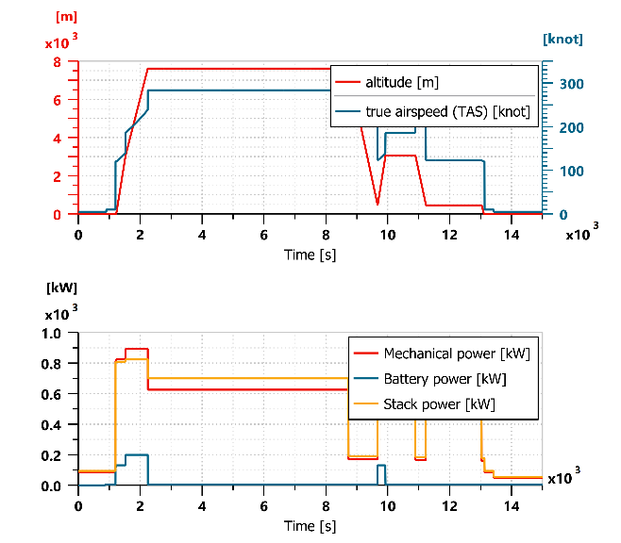
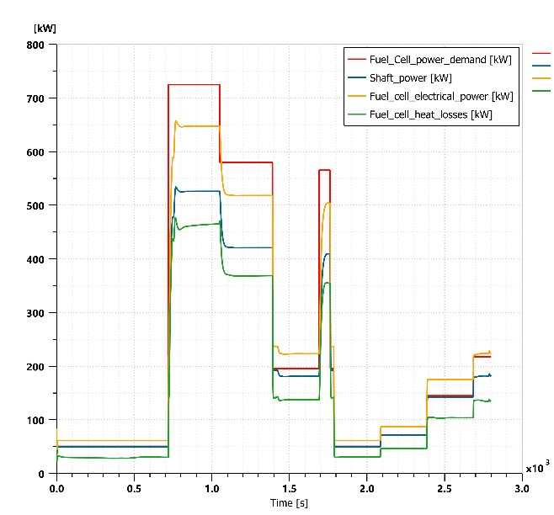
Preliminary results
Digital twin interaction studies
Energy balance
Temperatures
Transient mission
Stability and reliability verification
Notes:
Thanks to this preliminary digital twin, we can study first good behavioural responses for different variables of the system, like the energy balance as well as temperatures.
Such simulation are run with complete mission scenarios to manage the different stages of the flight in transient mode and not only on steady-state conditions.

Slide 15
Achievements
1st Digital twin running with consistent results
Based on physics
All fluids subsystem finalized
Last subsystem integration in progress
Digital twin stability and reliability verification
Continuous refinement reflecting several level of subsystem maturity thanks to consortium partners
Notes:
Finally, let us conclude on some achievements and the roadmap established by this very skilled and collaborative partnership to tackle a promising and challenging project.

Slide 16
Digital Twin roadmap
Digital twin for real control validation – 2nd half of 2024
Ground demonstrator
Digital twin ready for Clean aviation projects interaction in 2025
CS25 configuration
Notes:
Finally, let us conclude on some achievements and the roadmap established by this very skilled and collaborative partnership to tackle a promising and challenging project.
All components ready for subsystem integration - 2024 December
Subsystems integrated into the demonstrator - 2025 November
Ground demonstrator fully operational - 2026 February
Demonstration testing finished - 2026 May

Slide 17
Thank you
Jan Belak – Honeywell
Matthieu Ponchant - Siemens
02-08-2024
Notes:
Thank you all for your listening
Please feel free to ask your questions

